Slide 1

Manage Experiments
CS 20: TensorFlow for Deep Learning Research
Lecture 5
1/26/2017

Slide 3
Agenda
word2vec
Embedding visualization
Structure your TensorFlow model
Variable sharing
Manage experiments
Autodiff

Slide 4
Word Embedding
in TensorFlow

Slide 5
How do we represent words in an efficient way?

Slide 6
One-hot Representation
Each word is represented by one vector with a single 1 and the rest is 0

Slide 7
One-hot Representation
Each word is represented by one vector with a single 1 and the rest is 0
Example
Vocab: i, it, california, meh
i = [1 0 0 0]
it = [0 1 0 0]
california = [0 0 1 0]
meh = [0 0 0 1]

Slide 8
Problems with one-hot representation
Vocabulary can be large
=> massive dimension, inefficient computation
Can’t represent relationship between words
=> “anxious” and “nervous” are similar but would have completely different representations

Slide 9
Word Embedding
Distributed representation
Continuous values
Low dimension
Capture the semantic relationships between words

Slide 10
How?

Slide 11
Representing a word by means of its neighbors
“You shall know a word by the company it keeps.”
Firth, J. R. 1957:11

Slide 12
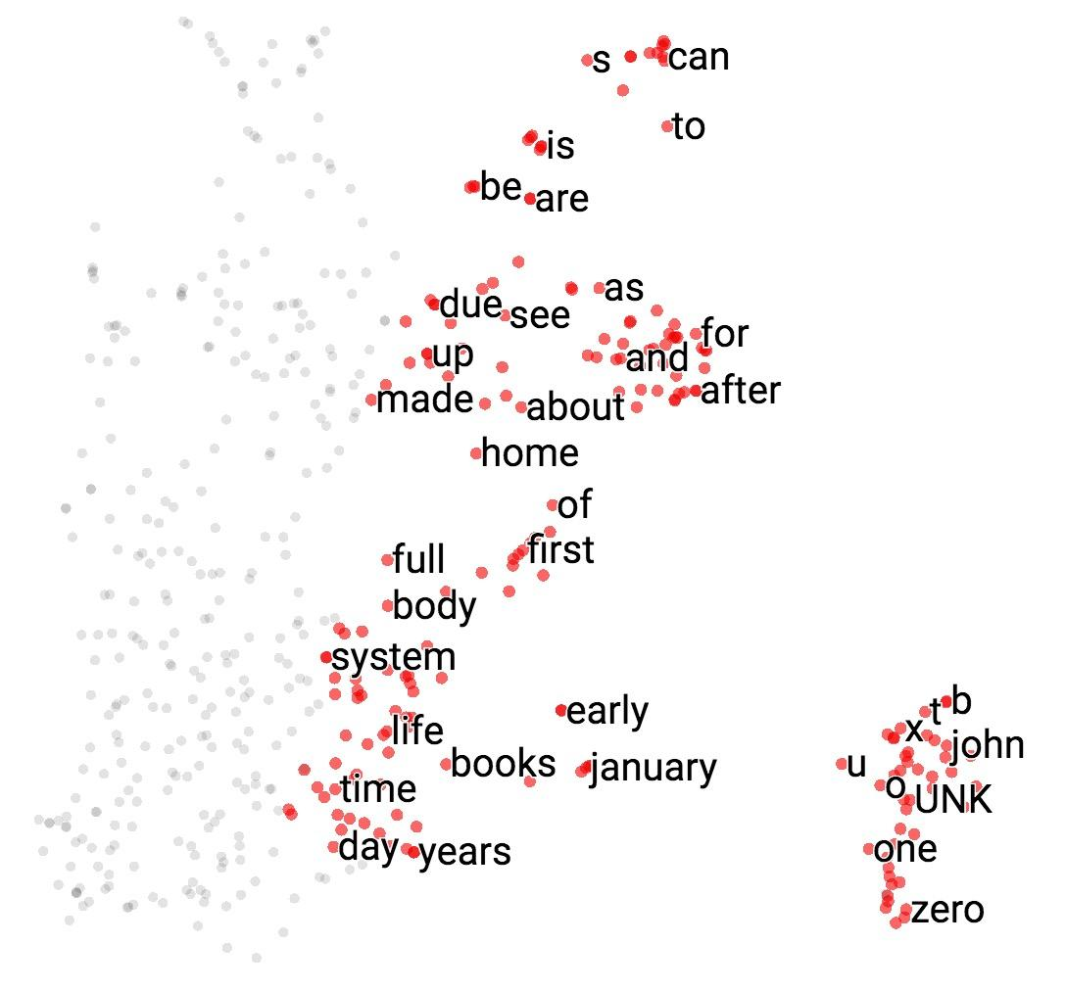
Word Embeddings

Slide 13
Live visualization
Notes:
tensorboard --logdir='processed'

Slide 14
Count vs Predict

Slide 15
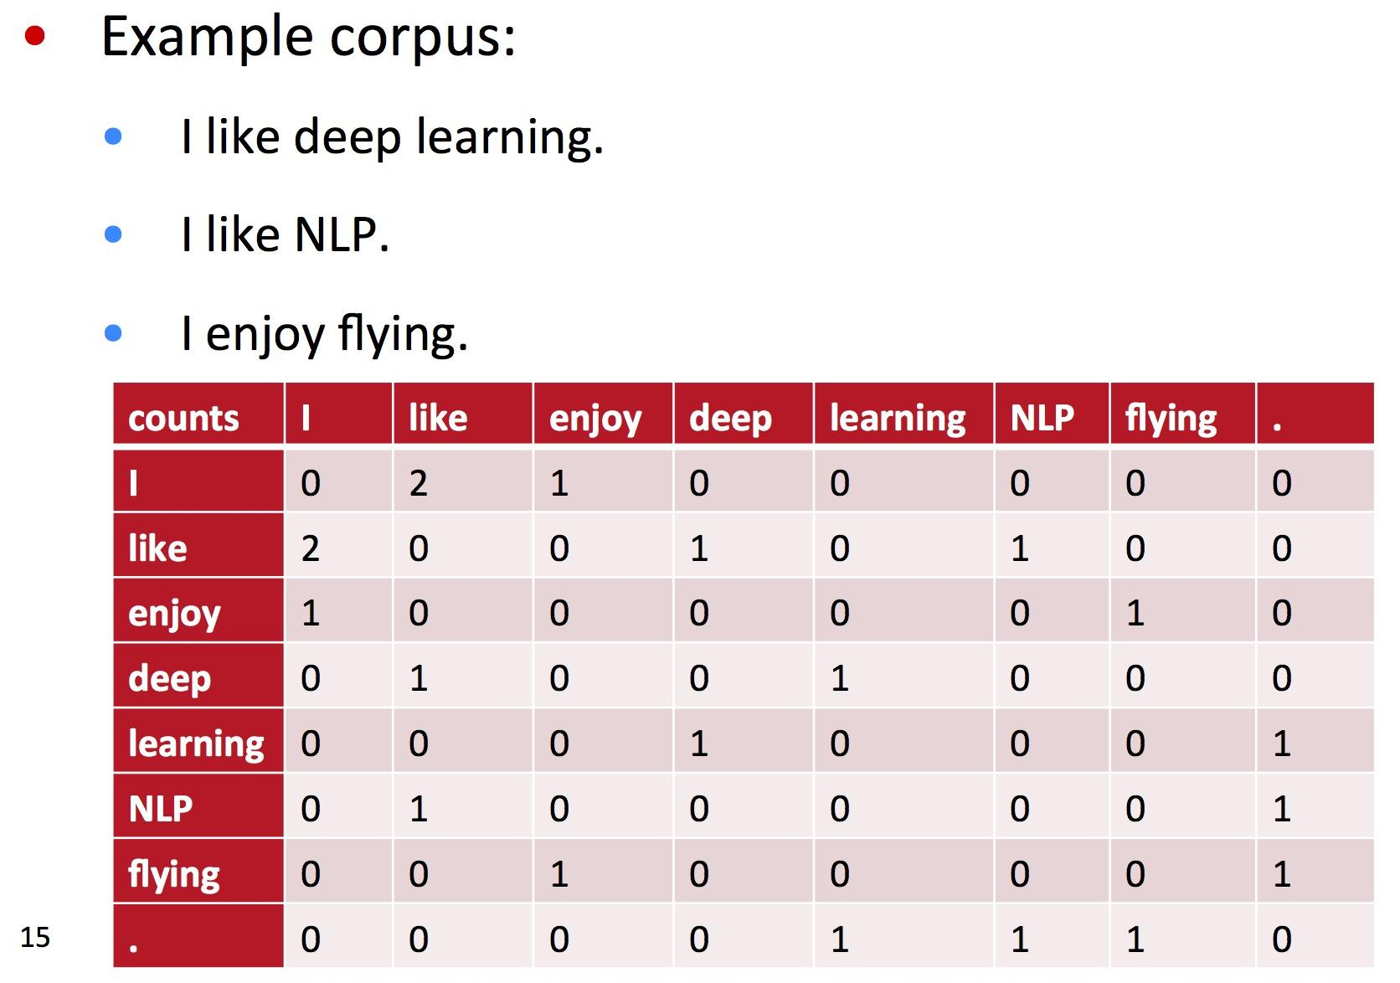
Counting
Graph by Richard Socher for CS224N

Slide 16
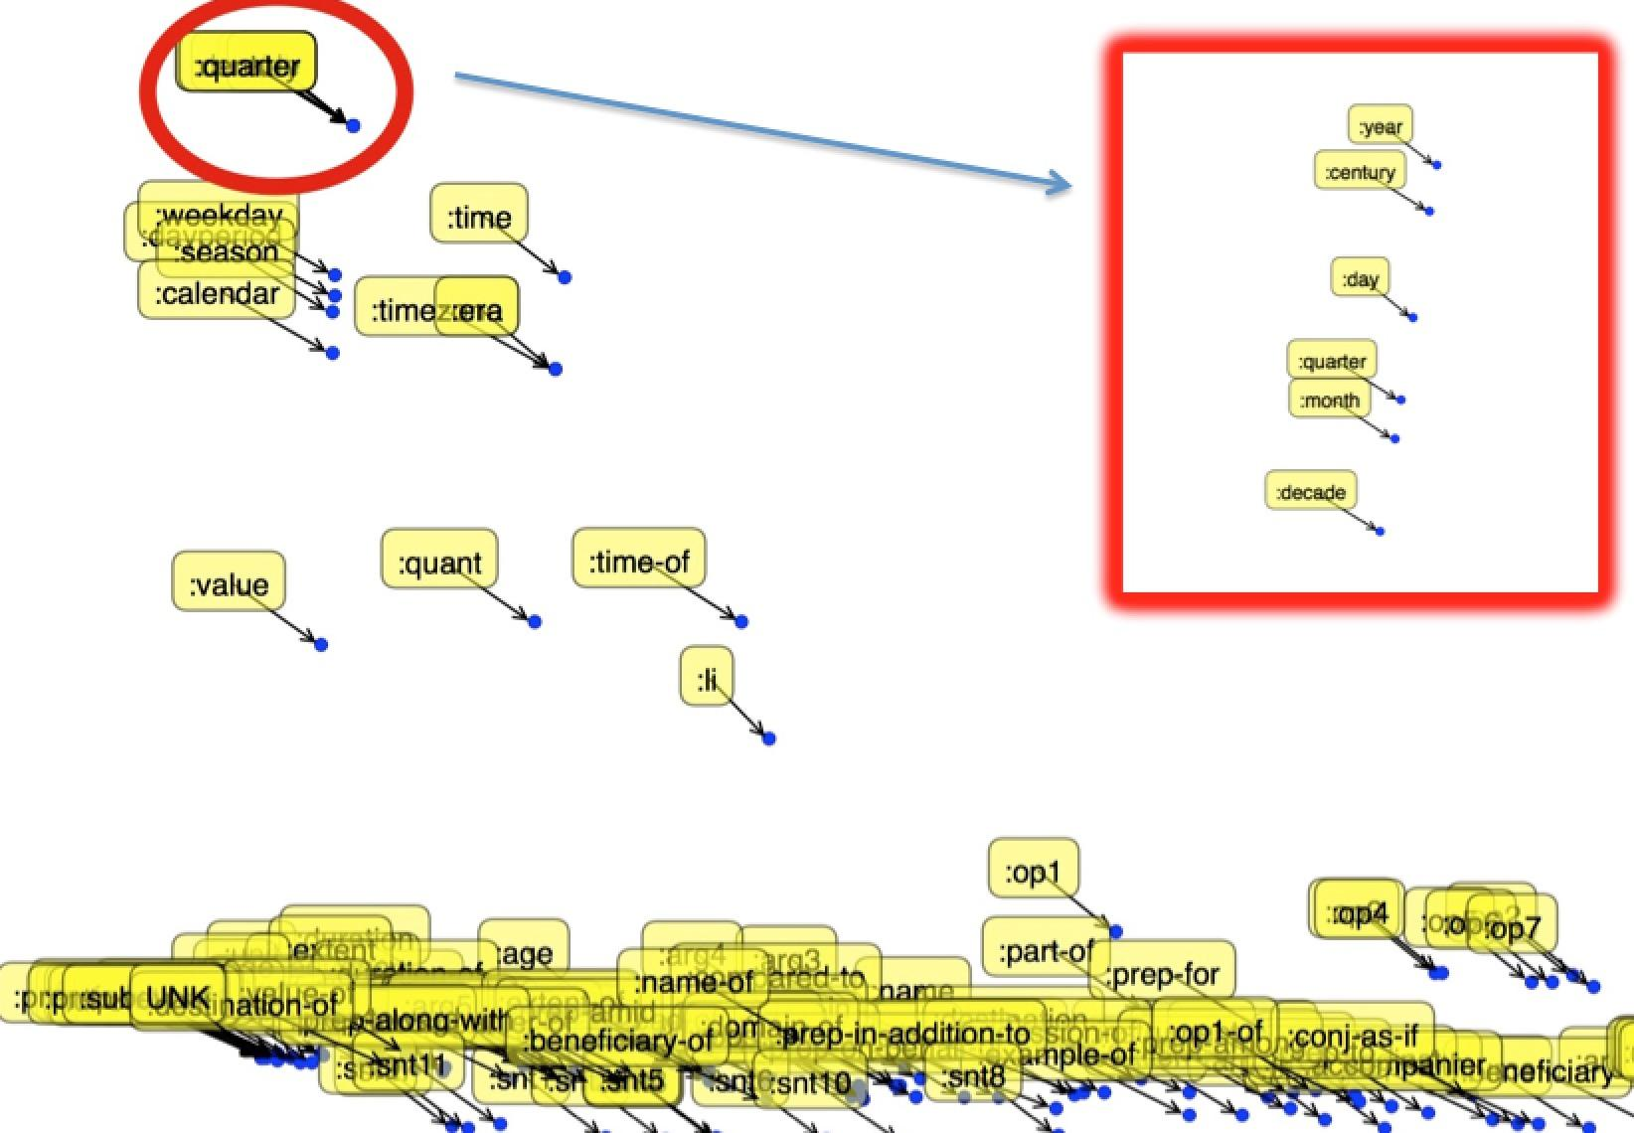
Counting
Simple but surprisingly effective

Slide 17
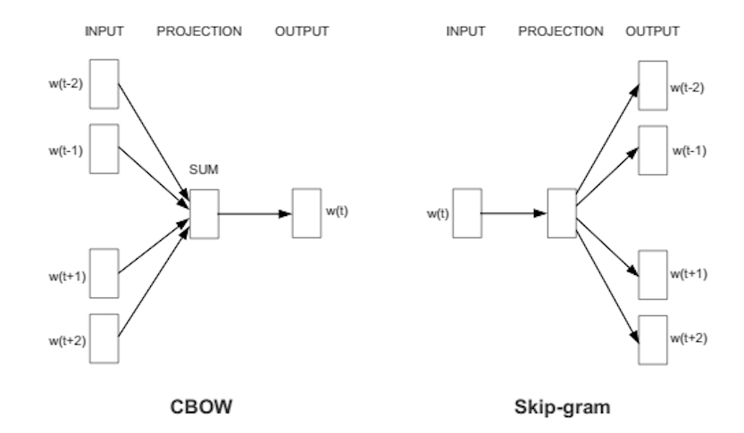
Predicting
Graph by deeplearning4j.org
Notes:
Algorithmically, these models are similar, except that CBOW predicts center words from context words, while the skip-gram does the inverse and predicts source context-words from the center words. For example, if we have the sentence: ""The quick brown fox jumps"", then CBOW tries to predict ""brown"" from ""the"", ""quick"", ""fox"", and ""jumps"", while skip-gram tries to predict ""the"", ""quick"", ""fox"", and ""jumps"" from ""brown"".
Statistically it has the effect that CBOW smoothes over a lot of the distributional information (by treating an entire context as one observation). For the most part, this turns out to be a useful thing for smaller datasets. However, skip-gram treats each context-target pair as a new observation, and this tends to do better when we have larger datasets.

Slide 18
Implementing word2vec skip-gram

Slide 19
Softmax vs Sample-based Approaches

Slide 20
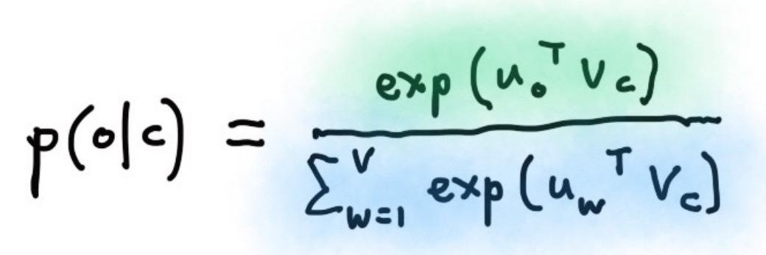
Softmax
Computationally expensive
Handwritten formula from a slide for CS224N

Slide 21
Sample-based Approaches
Negative Sampling
is a simplified version of
Noise Contrastive Estimation

Slide 22
Sample-based Approaches
NCE guarantees approximation to softmax
Negative Sampling doesn’t
For more information, see:
Sebastian Rudder’s “On word embeddings - Part 2: Approximating the Softmax”
Chris Dyer’s “Notes on Noise Contrastive Estimation and Negative Sampling”
Notes:
25 noise samples are sufficient to match the performance of the regular softmax, with an expected speed-up factor of about 45

Slide 23
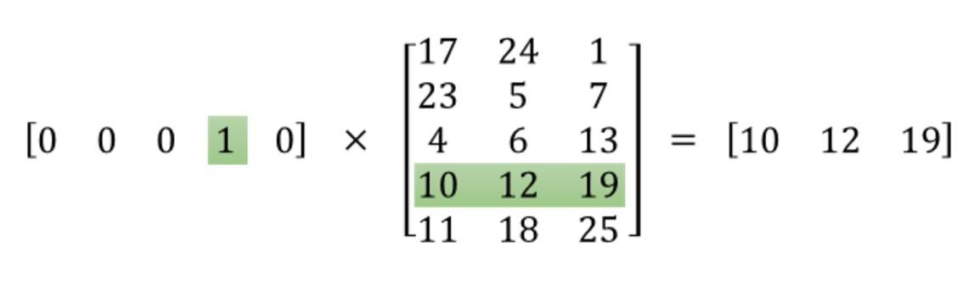
Embedding Lookup
Illustration by Chris McCormick

Slide 24
Embedding Lookup
tf.nn.embedding_lookup(params, ids, partition_strategy='mod', name=None, validate_indices=True, max_norm=None)
Illustration by Chris McCormick

Slide 25
NCE Loss
tf.nn.nce_loss(
weights,
biases,
labels,
inputs,
num_sampled,
num_classes,
num_true=1,
sampled_values=None,
remove_accidental_hits=False,
partition_strategy='mod',
name='nce_loss'
)

Slide 26
Word2vec in TensorFlow

Slide 27
Interactive Coding
word2vec_utils.py
04_word2vec_eager_starter.py

Slide 28
Structure your TensorFlow model

Slide 29
Phase 1: Assemble graph
1. Import data (with tf.data or placeholders)
2. Define the weights
3. Define the inference model
4. Define loss function
5. Define optimizer

Slide 30
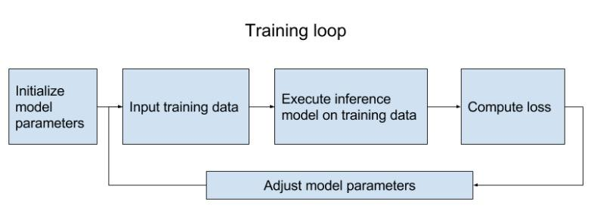
Phase 2: Compute
Graph from the book “TensorFlow for Machine Intelligence”

Slide 31
Need models to be reusable

Slide 32
Reusable models
Define a class for your model
Set up your model in a collection (e.g. map)
If you want to really reuse a model (without rebuilding it)
For big models that take a long time to build, save the graph_def in a file and then load it

Slide 33
Model as a class
class SkipGramModel:
""" Build the graph for word2vec model """
def __init__(self, params):
pass
def _import_data(self):
""" Step 1: import data """
pass
def _create_embedding(self):
""" Step 2: define weights. In word2vec, it's actually the weights that we care about """
pass
def _create_loss(self):
""" Step 3 + 4: define the inference + the loss function """
pass
def _create_optimizer(self):
""" Step 5: define optimizer """
pass
Yay, object oriented programming!!

Slide 34
Embedding visualization

Slide 35
Interactive Coding
04_word2vec_visualize.py

Slide 36
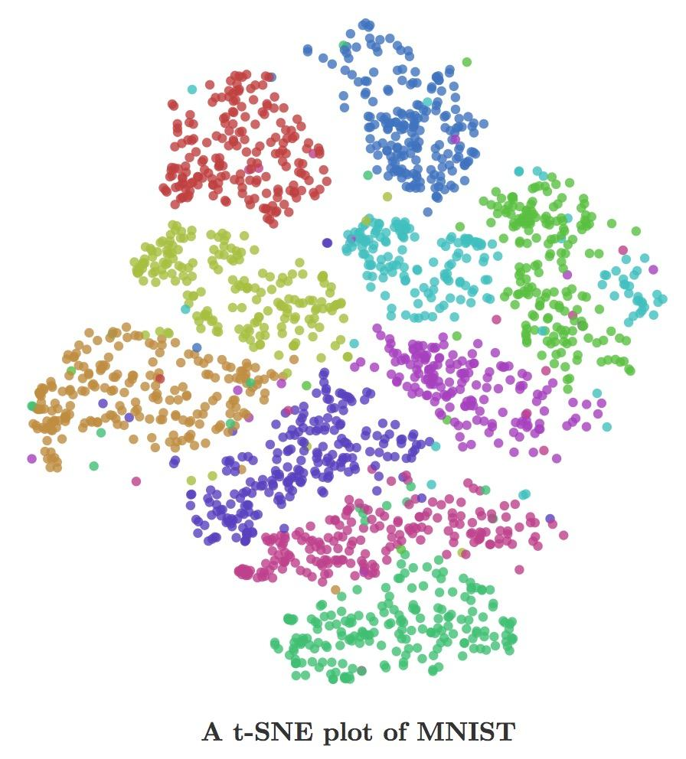
Visualize vector representation of anything
Visualization from Chris Olah’s blog

Slide 37
Variable sharing

Slide 38
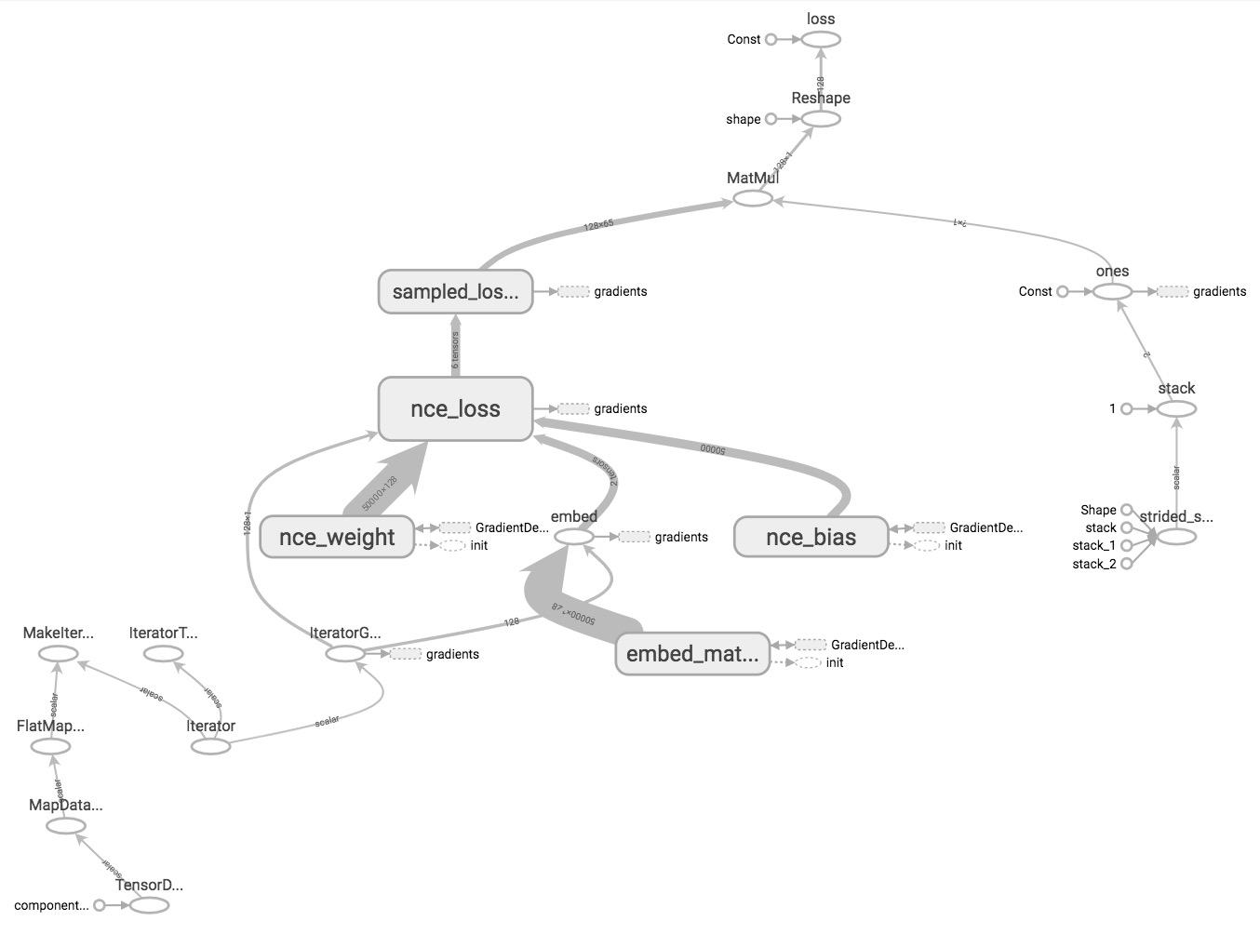
word2vec on TensorBoard

Slide 39
word2vec on TensorBoard
What if I have more complex models?

Slide 40
Name scope
TensorFlow doesn’t know what nodes should be grouped together, unless you tell it to

Slide 41
Name scope
Group nodes together with tf.name_scope(name)
with tf.name_scope(name_of_that_scope):
# declare op_1
# declare op_2
# ...

Slide 42
Name scope
with tf.name_scope('data'): iterator = dataset.make_initializable_iterator() center_words, target_words = iterator.get_next()
with tf.name_scope('embed'): embed_matrix = tf.get_variable('embed_matrix', shape=[VOCAB_SIZE, EMBED_SIZE], ...) embed = tf.nn.embedding_lookup(embed_matrix, center_words)
with tf.name_scope('loss'): nce_weight = tf.get_variable('nce_weight', shape=[VOCAB_SIZE, EMBED_SIZE], ...) nce_bias = tf.get_variable('nce_bias', initializer=tf.zeros([VOCAB_SIZE])) loss = tf.reduce_mean(tf.nn.nce_loss(weights=nce_weight, biases=nce_bias, …)
with tf.name_scope('optimizer'): optimizer = tf.train.GradientDescentOptimizer(LEARNING_RATE).minimize(loss)

Slide 43
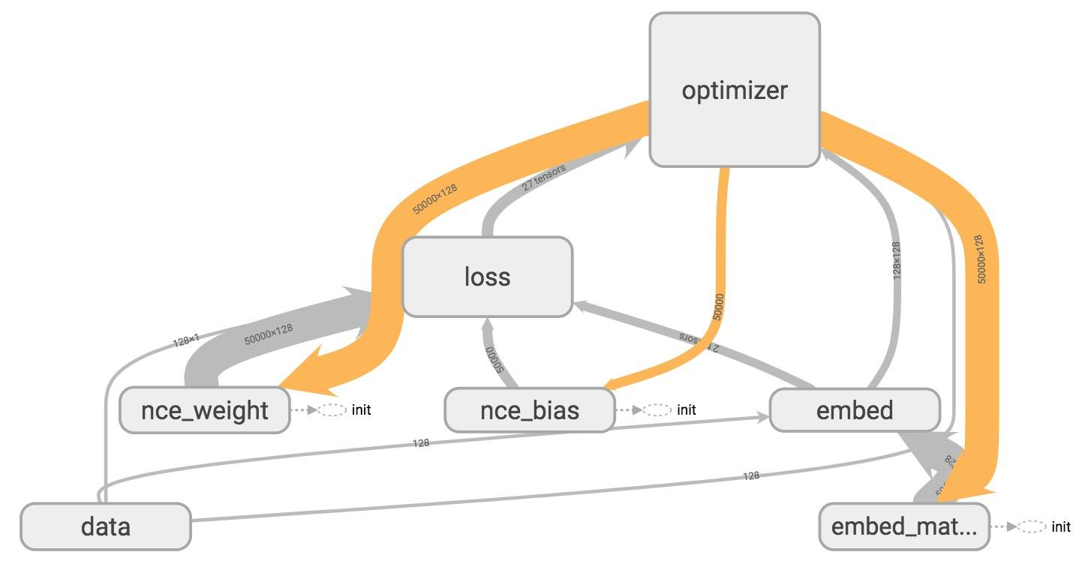
TensorBoard

Slide 44
Variable scope
Name scope vs variable scope
tf.name_scope() vs tf.variable_scope()

Slide 45
Variable scope
Name scope vs variable scope
Variable scope facilitates variable sharing

Slide 46
Variable sharing: The problem
def two_hidden_layers(x):
w1 = tf.Variable(tf.random_normal([100, 50]), name='h1_weights')
b1 = tf.Variable(tf.zeros([50]), name='h1_biases')
h1 = tf.matmul(x, w1) + b1
w2 = tf.Variable(tf.random_normal([50, 10]), name='h2_weights')
b2 = tf.Variable(tf.zeros([10]), name='2_biases')
logits = tf.matmul(h1, w2) + b2
return logits

Slide 47
Variable sharing: The problem
def two_hidden_layers(x):
w1 = tf.Variable(tf.random_normal([100, 50]), name='h1_weights')
b1 = tf.Variable(tf.zeros([50]), name='h1_biases')
h1 = tf.matmul(x, w1) + b1
w2 = tf.Variable(tf.random_normal([50, 10]), name='h2_weights')
b2 = tf.Variable(tf.zeros([10]), name='2_biases')
logits = tf.matmul(h1, w2) + b2
return logits
logits1 = two_hidden_layers(x1)
logits2 = two_hidden_layers(x2)
What will happen if we make these two calls?

Slide 48
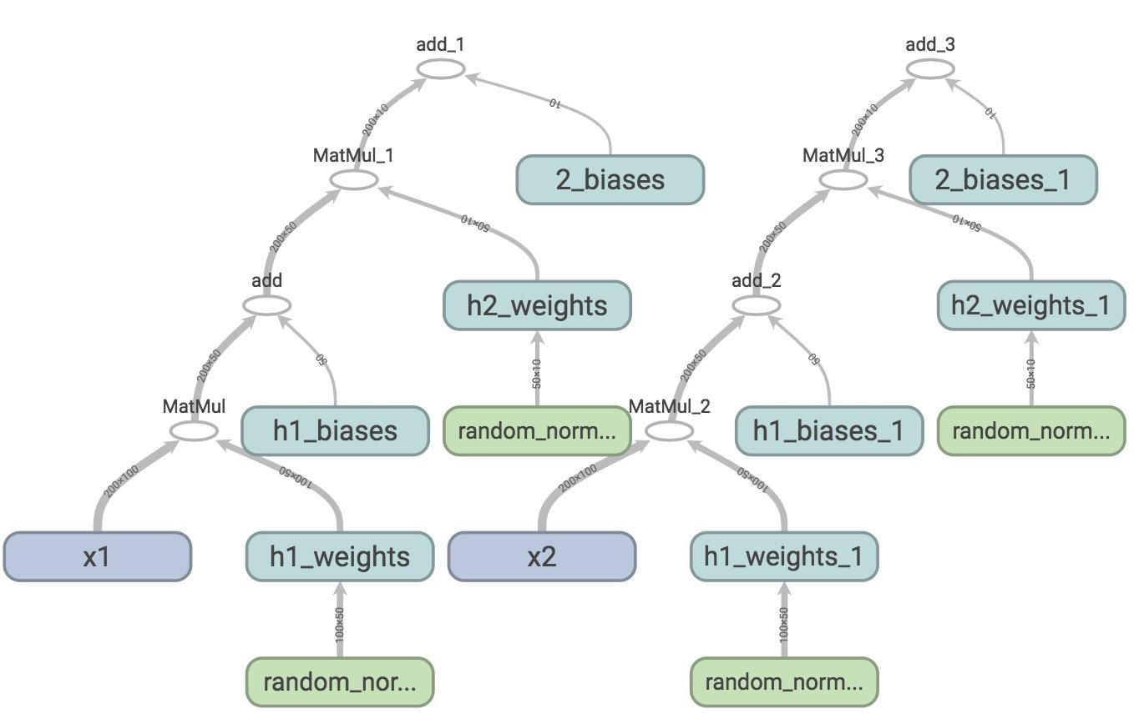
Sharing Variable: The problem
Two sets of variables are created.
You want all your inputs to use the same weights and biases!

Slide 49
tf.get_variable()
tf.get_variable(<name>, <shape>, <initializer>)
If a variable with <name> already exists, reuse it
If not, initialize it with <shape> using <initializer>

Slide 50
tf.get_variable()
def two_hidden_layers(x):
assert x.shape.as_list() == [200, 100]
w1 = tf.get_variable("h1_weights", [100, 50], initializer=tf.random_normal_initializer())
b1 = tf.get_variable("h1_biases", [50], initializer=tf.constant_initializer(0.0))
h1 = tf.matmul(x, w1) + b1
assert h1.shape.as_list() == [200, 50]
w2 = tf.get_variable("h2_weights", [50, 10], initializer=tf.random_normal_initializer())
b2 = tf.get_variable("h2_biases", [10], initializer=tf.constant_initializer(0.0))
logits = tf.matmul(h1, w2) + b2
return logits
logits1 = two_hidden_layers(x1)
logits2 = two_hidden_layers(x2)

Slide 51
tf.get_variable()
def two_hidden_layers(x):
assert x.shape.as_list() == [200, 100]
w1 = tf.get_variable("h1_weights", [100, 50], initializer=tf.random_normal_initializer())
b1 = tf.get_variable("h1_biases", [50], initializer=tf.constant_initializer(0.0))
h1 = tf.matmul(x, w1) + b1
assert h1.shape.as_list() == [200, 50]
w2 = tf.get_variable("h2_weights", [50, 10], initializer=tf.random_normal_initializer())
b2 = tf.get_variable("h2_biases", [10], initializer=tf.constant_initializer(0.0))
logits = tf.matmul(h1, w2) + b2
return logits
logits1 = two_hidden_layers(x1)
logits2 = two_hidden_layers(x2)
ValueError: Variable h1_weights already exists, disallowed. Did you mean to set reuse=True in VarScope?

Slide 52
tf.variable_scope()
def two_hidden_layers(x):
assert x.shape.as_list() == [200, 100]
w1 = tf.get_variable("h1_weights", [100, 50], initializer=tf.random_normal_initializer())
b1 = tf.get_variable("h1_biases", [50], initializer=tf.constant_initializer(0.0))
h1 = tf.matmul(x, w1) + b1
assert h1.shape.as_list() == [200, 50]
w2 = tf.get_variable("h2_weights", [50, 10], initializer=tf.random_normal_initializer())
b2 = tf.get_variable("h2_biases", [10], initializer=tf.constant_initializer(0.0))
logits = tf.matmul(h1, w2) + b2
return logits
with tf.variable_scope('two_layers') as scope:
logits1 = two_hidden_layers(x1)
scope.reuse_variables()
logits2 = two_hidden_layers(x2)
Put your variables within a scope and reuse all variables within that scope

Slide 53
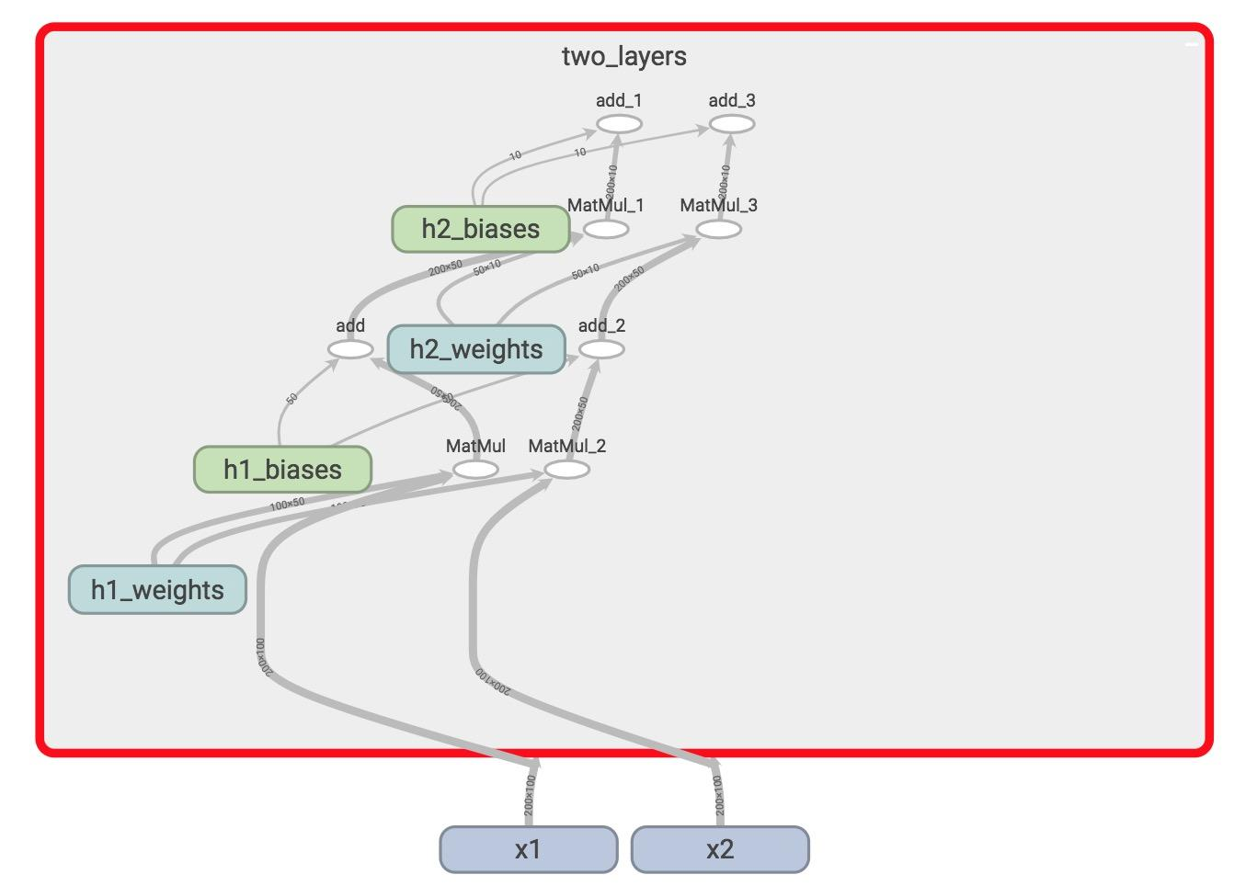
tf.variable_scope()
Only one set of variables, all within the variable scope “two_layers”
They take in two different inputs

Slide 54
tf.variable_scope()
tf.variable_scope implicitly creates a name scope

Slide 55
Reusable code?
def two_hidden_layers(x):
assert x.shape.as_list() == [200, 100]
w1 = tf.get_variable("h1_weights", [100, 50], initializer=tf.random_normal_initializer())
b1 = tf.get_variable("h1_biases", [50], initializer=tf.constant_initializer(0.0))
h1 = tf.matmul(x, w1) + b1
assert h1.shape.as_list() == [200, 50]
w2 = tf.get_variable("h2_weights", [50, 10], initializer=tf.random_normal_initializer())
b2 = tf.get_variable("h2_biases", [10], initializer=tf.constant_initializer(0.0))
logits = tf.matmul(h1, w2) + b2
return logits
with tf.variable_scope('two_layers') as scope:
logits1 = two_hidden_layers(x1)
scope.reuse_variables()
logits2 = two_hidden_layers(x2)

Slide 56
Layer ‘em up
def fully_connected(x, output_dim, scope):
with tf.variable_scope(scope, reuse=tf.AUTO_REUSE) as scope:
w = tf.get_variable("weights", [x.shape[1], output_dim], initializer=tf.random_normal_initializer())
b = tf.get_variable("biases", [output_dim], initializer=tf.constant_initializer(0.0))
return tf.matmul(x, w) + b
def two_hidden_layers(x):
h1 = fully_connected(x, 50, 'h1')
h2 = fully_connected(h1, 10, 'h2')
with tf.variable_scope('two_layers') as scope:
logits1 = two_hidden_layers(x1)
logits2 = two_hidden_layers(x2)
Fetch variables if they already exist
Else, create them

Slide 57
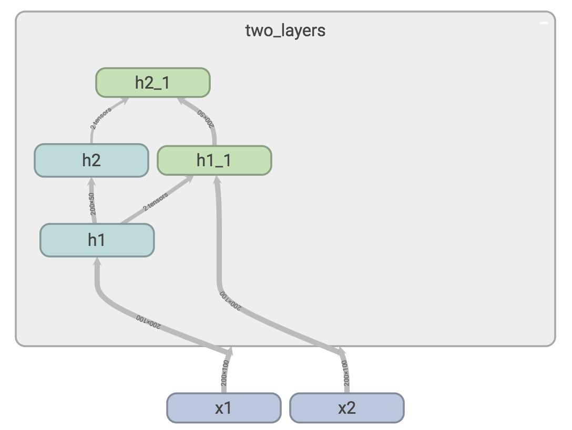
Layer ‘em up

Slide 58
Manage Experiments

Slide 59
tf.train.Saver
saves graph’s variables in binary files
Notes:
A good practice is to periodically save the model’s parameters after a certain number of steps so that we can restore/retrain our model from that step if need be. The tf.train.Saver() class allows us to do so by saving the graph’s variables in binary files.

Slide 60
Saves sessions, not graphs!
tf.train.Saver.save(sess, save_path, global_step=None...)
tf.train.Saver.restore(sess, save_path)

Slide 61
Save parameters after 1000 steps
# define model
model = SkipGramModel(params)
# create a saver object
saver = tf.train.Saver()
with tf.Session() as sess:
for step in range(training_steps):
sess.run([optimizer])
# save model every 1000 steps
if (step + 1) % 1000 == 0:
saver.save(sess,
'checkpoint_directory/model_name',
global_step=step)

Slide 62
Specify the step at which the model is saved
# define model
model = SkipGramModel(params)
# create a saver object
saver = tf.train.Saver()
with tf.Session() as sess:
for step in range(training_steps):
sess.run([optimizer])
# save model every 1000 steps
if (step + 1) % 1000 == 0:
saver.save(sess,
'checkpoint_directory/model_name',
global_step=step)
Notes:
In TensorFlow lingo, the step at which you save your graph’s variables is called a checkpoint. Since we will be creating many checkpoints, it’s helpful to append the number of training steps our model has gone through in a variable called global_step. It’s a very common variable to see in TensorFlow program. We first need to create it, initialize it to 0 and set it to be not trainable, since we don’t want to TensorFlow to optimize it.

Slide 63
Global step
global_step = tf.Variable(0, dtype=tf.int32, trainable=False, name='global_step')
Very common in TensorFlow program
Notes:
Trainable is false

Slide 64
Global step
global_step = tf.Variable(0,
dtype=tf.int32,
trainable=False,
name='global_step')
optimizer = tf.train.AdamOptimizer(lr).minimize(loss, global_step=global_step)
Need to tell optimizer to increment global step
This can also help your optimizer know when to decay learning rate

Slide 65
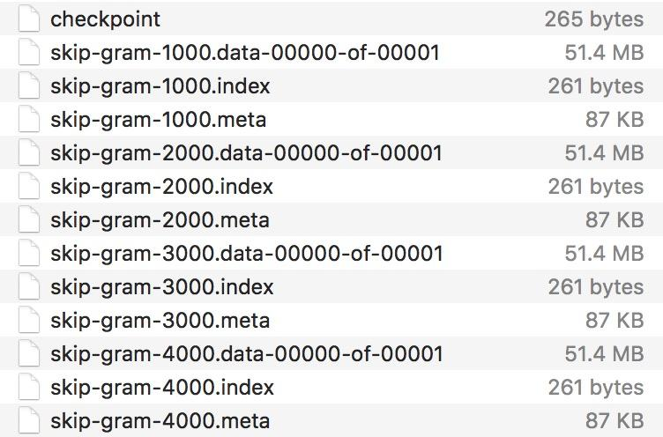
Your checkpoints are saved in checkpoint_directory
Notes:
Trainable is false. if you use decay learning rate, of course

Slide 66
tf.train.Saver
Only save variables, not graph
Checkpoints map variable names to tensors
Notes:
Still need to build your graph

Slide 67
tf.train.Saver
Can also choose to save certain variables
v1 = tf.Variable(..., name='v1')
v2 = tf.Variable(..., name='v2')
You can save your variables in one of three ways:
saver = tf.train.Saver({'v1': v1, 'v2': v2})
saver = tf.train.Saver([v1, v2])
saver = tf.train.Saver({v.op.name: v for v in [v1, v2]}) # similar to a dict

Slide 68
Restore variables
saver.restore(sess, 'checkpoints/name_of_the_checkpoint')
e.g. saver.restore(sess, 'checkpoints/skip-gram-99999')
Still need to first build graph

Slide 69
Restore the latest checkpoint
# check if there is checkpoint
ckpt = tf.train.get_checkpoint_state(os.path.dirname('checkpoints/checkpoint'))
# check if there is a valid checkpoint path
if ckpt and ckpt.model_checkpoint_path:
saver.restore(sess, ckpt.model_checkpoint_path)
checkpoint file keeps track of the latest checkpoint
restore checkpoints only when there is a valid checkpoint path

Slide 70
tf.summary
Why matplotlib when you can summarize?

Slide 71
tf.summary
Visualize our summary statistics during our training
tf.summary.scalar
tf.summary.histogram
tf.summary.image

Slide 72
Step 1: create summaries
with tf.name_scope("summaries"):
tf.summary.scalar("loss", self.loss)
tf.summary.scalar("accuracy", self.accuracy)
tf.summary.histogram("histogram loss", self.loss)
summary_op = tf.summary.merge_all()
merge them all into one summary op to make managing them easier

Slide 73
Step 2: run them
loss_batch, _, summary = sess.run([loss,
optimizer,
summary_op])
Like everything else in TF, summaries are ops.
For the summaries to be built, you have to run it in a session

Slide 74
Step 3: write summaries to file
writer.add_summary(summary, global_step=step)
Need global step here so the model knows what summary corresponds to what step

Slide 75
Putting it together
tf.summary.scalar("loss", self.loss)
tf.summary.histogram("histogram loss", self.loss)
summary_op = tf.summary.merge_all()
saver = tf.train.Saver() # defaults to saving all variables
with tf.Session() as sess:
sess.run(tf.global_variables_initializer())
ckpt = tf.train.get_checkpoint_state(os.path.dirname('checkpoints/checkpoint'))
if ckpt and ckpt.model_checkpoint_path:
saver.restore(sess, ckpt.model_checkpoint_path)
writer = tf.summary.FileWriter('./graphs', sess.graph)
for index in range(10000):
...
loss_batch, _, summary = sess.run([loss, optimizer, summary_op])
writer.add_summary(summary, global_step=index)
if (index + 1) % 1000 == 0:
saver.save(sess, 'checkpoints/skip-gram', index)

Slide 76
See summaries on TensorBoard
Notes:
Live visualization

Slide 77
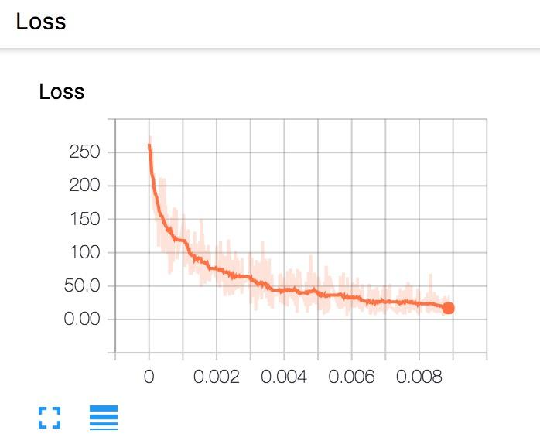
Scalar loss

Slide 78
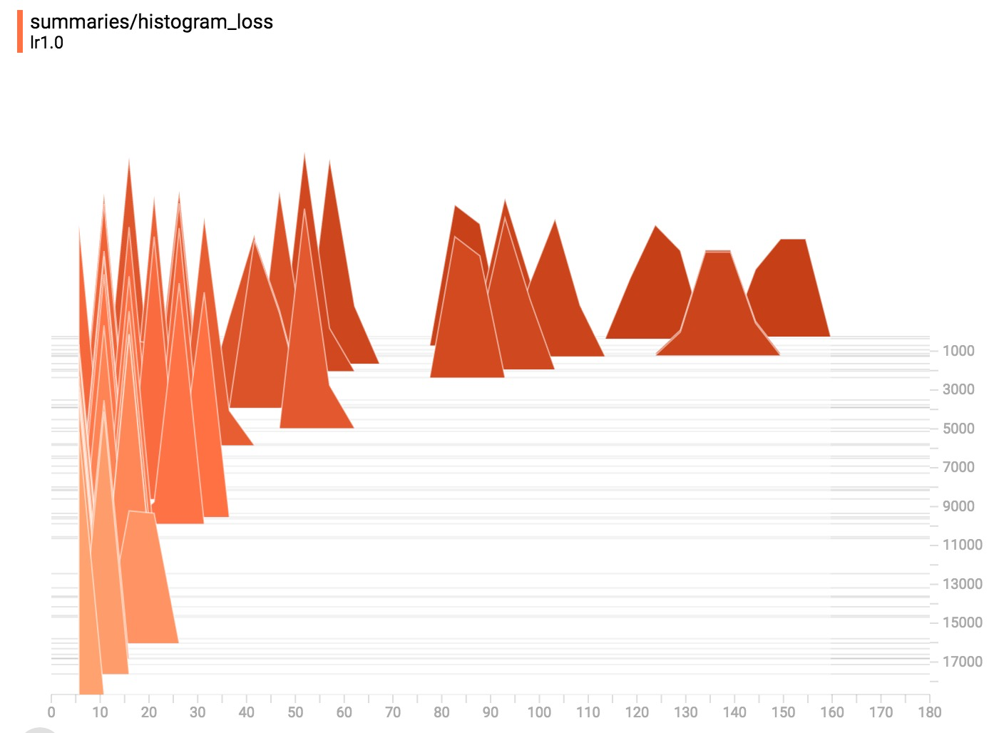
Histogram loss

Slide 79
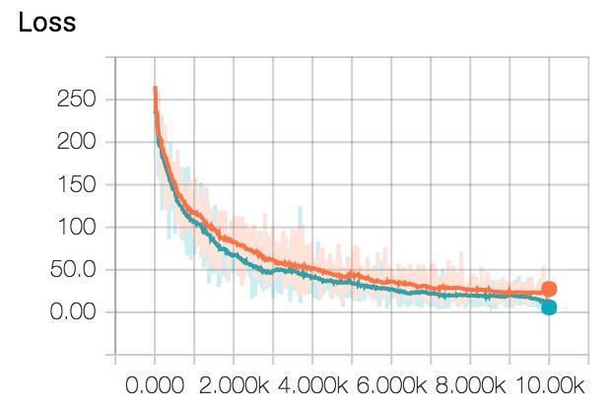
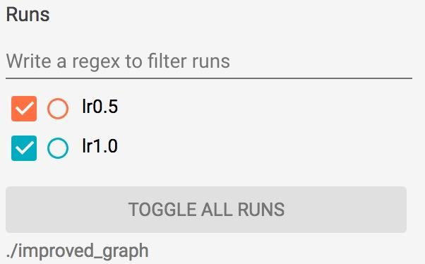
Toggle run to compare experiments
Notes:
If you save your summaries into different sub-folder in your graph folder, you can compare your progresses. For example, the first time we run our model with learning rate 1.0, we save it in ‘improved_graph/lr1.0’ and the second time we run our model, we save it in ‘improved_graph/lr0.5’

Slide 80
Control Randomization
Notes:
We need to

Slide 81
Op level random seed
my_var = tf.Variable(tf.truncated_normal((-1.0,1.0), stddev=0.1, seed=0))

Slide 82
Sessions keep track of random state
c = tf.random_uniform([], -10, 10, seed=2)
with tf.Session() as sess:
print(sess.run(c)) # >> 3.57493
print(sess.run(c)) # >> -5.97319
----
c = tf.random_uniform([], -10, 10, seed=2)
with tf.Session() as sess:
print(sess.run(c)) # >> 3.57493
with tf.Session() as sess:
print(sess.run(c)) # >> 3.57493
Each new session restarts the random state

Slide 83
Op level seed: each op keeps its own seed
c = tf.random_uniform([], -10, 10, seed=2)
d = tf.random_uniform([], -10, 10, seed=2)
with tf.Session() as sess:
print(sess.run(c)) # >> 3.57493
print(sess.run(d)) # >> 3.57493

Slide 84
Graph level seed
tf.set_random_seed(2)
c = tf.random_uniform([], -10, 10)
d = tf.random_uniform([], -10, 10)
with tf.Session() as sess:
print(sess.run(c)) # >> -4.00752
print(sess.run(d)) # >> -2.98339
Note that the result is different from op-level seed
Notes:
Example (live coding)

Slide 85
Autodiff

Slide 86
Where are the gradients?
Notes:
We have built 3 models so far and we haven’t taken a single gradient. All we needed to do was to specify the forward path and boom, we’re done.
For example, if tensor C depends on a set of previous nodes, the gradient of C with respect to those previous nodes can be automatically computed with a built-in function, even if there are many layers in between them.

Slide 87
TensorFlow builds the backward path for you!
Notes:
Path between two tensors

Slide 88
Reverse mode automatic differentiation
The computation graph makes computing symbolic gradients straightforward
Chain rule
Notes:
Path between two tensors

Slide 89
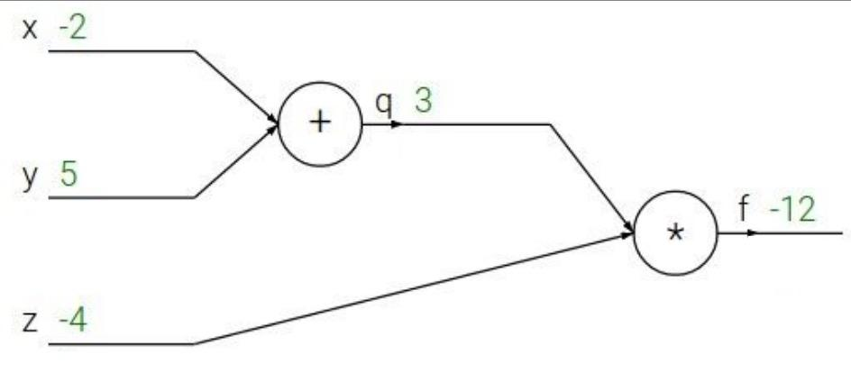
Can you take gradients for this graph?
1
Notes:
Path between two tensors

Slide 90
Reverse mode automatic differentiation
-4
-4
-4
1
3
Notes:
Path between two tensors

Slide 91
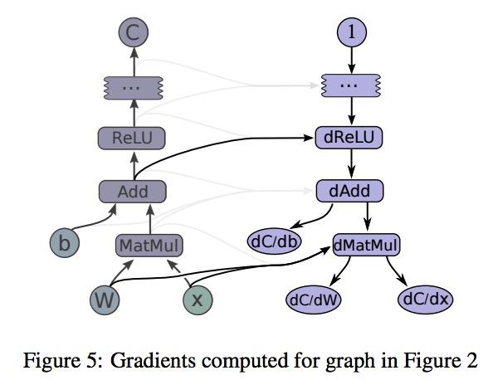
Reverse mode automatic differentiation

Slide 92
Reverse mode automatic differentiation
The backward path takes the same time as forward path

Slide 93
tf.gradients(y, [xs])
Take derivative of y with respect to each tensor
in the list [xs]
Notes:
Gradient checker
[f(x+e)-f(x-e)]/(2e)

Slide 94
tf.gradients(y, [xs])
x = tf.Variable(2.0)
y = 2.0 * (x ** 3)
z = 3.0 + y ** 2
grad_z = tf.gradients(z, [x, y])
with tf.Session() as sess:
sess.run(x.initializer)
print(sess.run(grad_z)) # >> [768.0, 32.0]
# 768 is the gradient of z with respect to x, 32 with respect to y
Notes:
Gradient checker
[f(x+e)-f(x-e)]/(2e)

Slide 95
Gradient Computation
tf.gradients(ys, xs, grad_ys=None, ...)
tf.stop_gradient(input, name=None)
# prevents the contribution of its inputs to be taken into account
tf.clip_by_value(t, clip_value_min, clip_value_max, name=None)
tf.clip_by_norm(t, clip_norm, axes=None, name=None)

Slide 96
Should I still learn to take gradients?
Notes:
Is it going to be obsolete like trying to take square root of something after the invention of calculator?

Slide 97
Yes

Slide 98
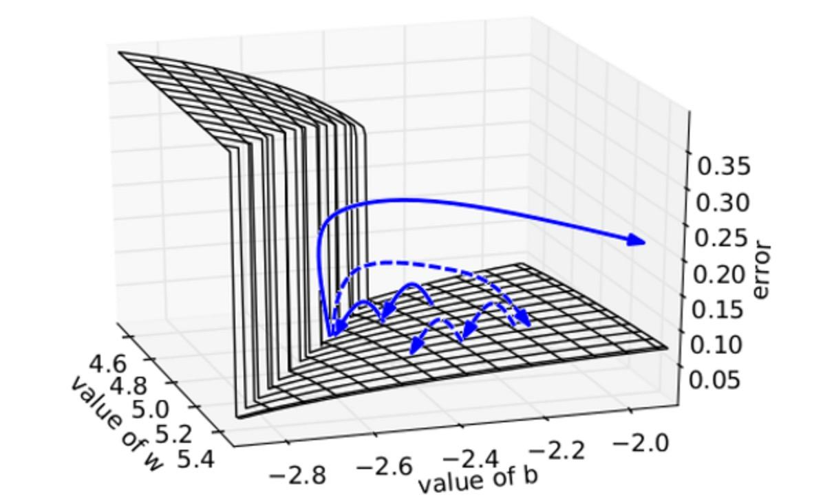
Vanishing/exploding gradients
Plot by “Understanding the exploding gradient problem”, Pascanu et al. (2012)
Notes:
Traditional activation functions such as the hyperbolic tangent function have gradients in the range (−1, 1) or [0, 1), and backpropagation computes gradients by the chain rule. This has the effect of multiplying n of these small numbers to compute gradients of the "front" layers in an n-layer network, meaning that the gradient (error signal) decreases exponentially with n and the front layers train very slowly.

Slide 99
Next class
Computer Vision
Convolution
Convnet
No class on Friday, 2/2
Feedback: huyenn@stanford.edu
Thanks!

